Slide 1
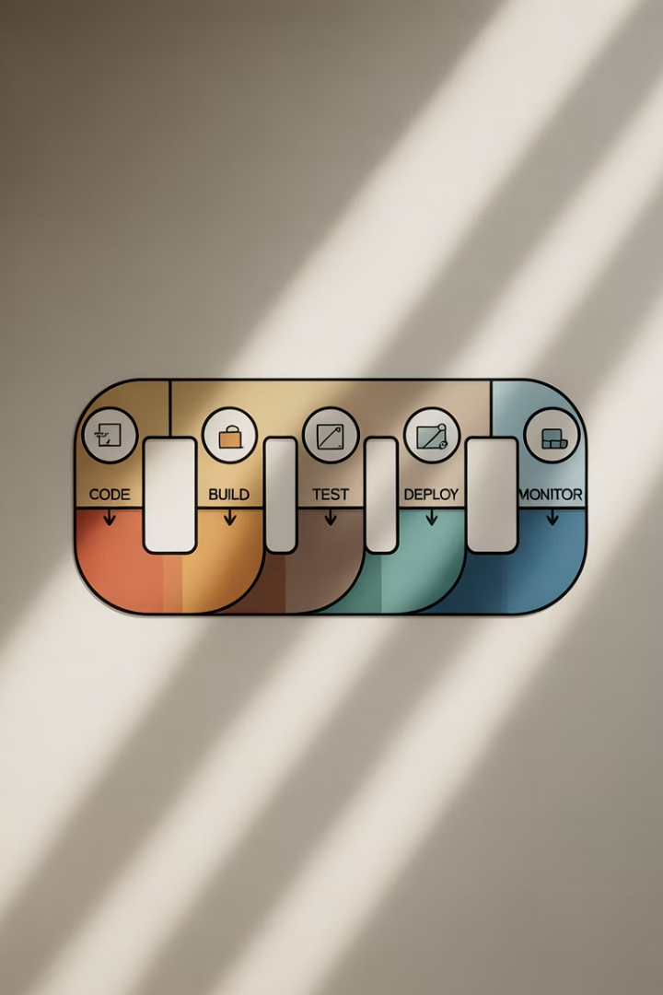

DevOps CI/CD Pipeline for ABC Retail Application
A complete DevOps implementation transforming ABC's traditional retail application into a modern, cloud-native solution with continuous integration and deployment.
by Vaibhav oza

Slide 2




Project Setup & Goals
Objective
Business Goal
Build a complete DevOps pipeline from code push to deployment and monitoring.
Transform ABC's traditional retail app into a modern, CI/CD-enabled cloud-native application.
Initial Setup
Java, Maven, Git, Docker, Jenkins, Ansible installed on WSL2 Ubuntu.

Slide 3



GitHub Integration
Code Repository
Documentation
Project Guides
Project source code pushed to GitHub repository: devOPS_Project1.
Comprehensive screenshots and documentation folders created as supporting evidence.
Readme and Markdown files generated to explain project details and usage.

Slide 4
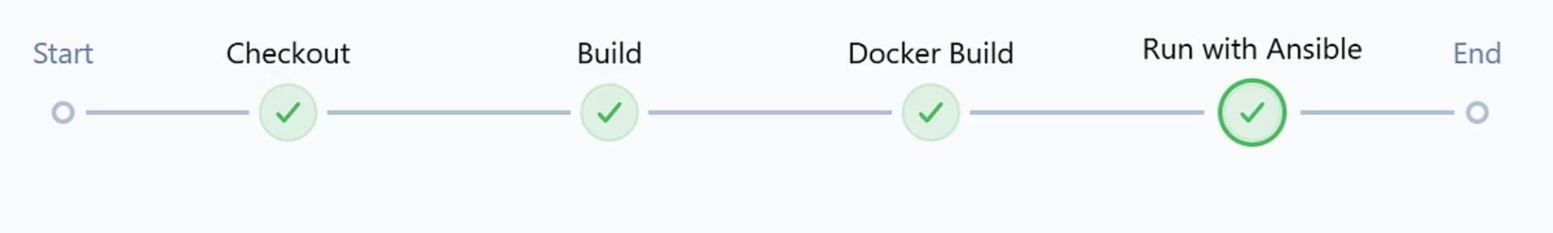




CI/CD Pipeline with Jenkins
Clone Repository
Pull latest code from GitHub.
Build WAR
Compile application using Maven.
Build Docker Image
Create abc-retail-app container image.
Deploy with Ansible
Trigger playbook to launch container.

Slide 5

Docker Integration
Run Container
Build Image
Launch container on port 9090 and verify accessibility.
Create Dockerfile
Run docker build -t abc-retail-app:latest command.
Use Tomcat 9 base image and copy WAR into webapps/ROOT.war.

Slide 7








Ansible Automation
Create Playbook
Jenkins Integration
Write run_docker.yml to automate container deployment.
Connect Ansible with Jenkins pipeline.
Verify Deployment
Execute Playbook
Confirm container is running properly.
Run automation to launch container.

Slide 8




Kubernetes Deployment
Minikube Setup
YAML Configuration
Service Exposure
Start Minikube using Docker driver.
Access app via minikube service retail-service.
Create deployment.yaml and service.yaml files.

Slide 9
Monitoring with Prometheus
Installed on port 9091
Node Exporter on port 9100
Configured prometheus.yml

Slide 10
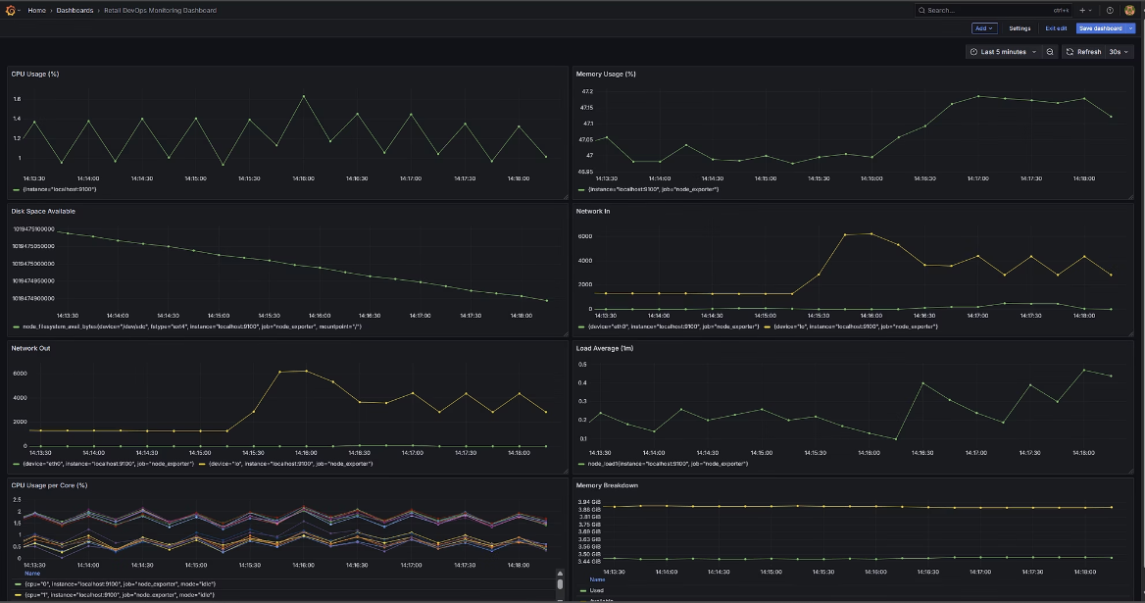
Monitoring with Grafana
Grafana is used to visualize and analyze the metrics collected by Prometheus for the ABC Retail application.
It provides interactive dashboards that display real-time data on application performance, resource usage, and system health.
Configured to connect to the Prometheus data source, enabling team members to monitor and troubleshoot effectively.

Slide 11
Documentation & Evidence
Comprehensive documentation includes screenshots, markdown guides, and organized project structure with dedicated folders for each component available in the github repository.

Slide 12

Final Outcome
100%
24/7
Automation
Monitoring
Full CI/CD pipeline from code to deployment
Real-time metrics via Grafana dashboards
3x
Scalability
Improved application scaling with Kubernetes

